Slide 1
Computational Physics
Lesson 2 – Differential Equations

Slide 2

Computational Physic
Lesson 2 – Differential Equations

Slide 3
Learning Objectives
Understand that many problems in physics are posed as differential equations.
Write code to implement simple methods to solve differential equations.
Appreciate the importance of choosing an appropriate timestep.

Slide 4
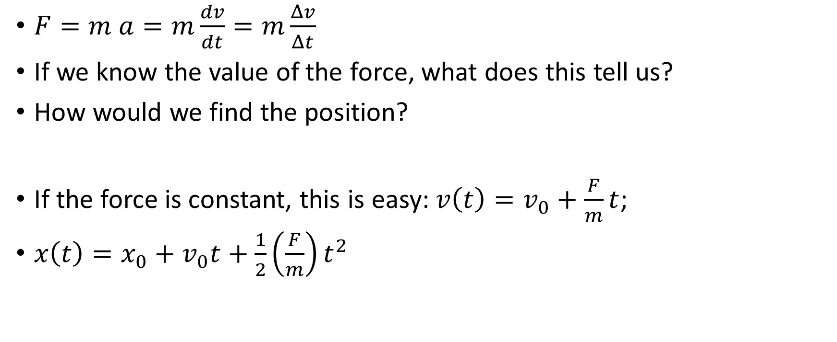
Example – Newton’s 3rd Law
$F=m a=m\frac{dv}{dt}=m\frac{Δv}{Δt}$
If we know the value of the force, what does this tell us?
How would we find the position?
If the force is constant, this is easy: $v\left(t\right)=v_{0}+\frac{F}{m}t$;
$x\left(t\right)=x_{0}+v_{0}t+\frac{1}{2}\left(\frac{F}{m}\right)t^{2}$

Slide 5
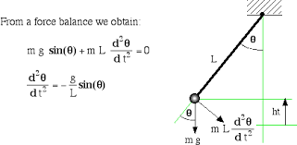
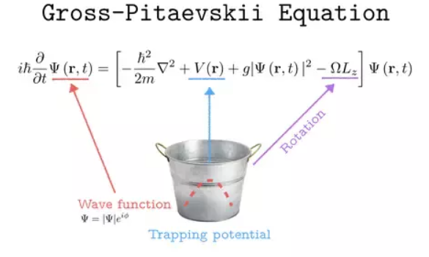
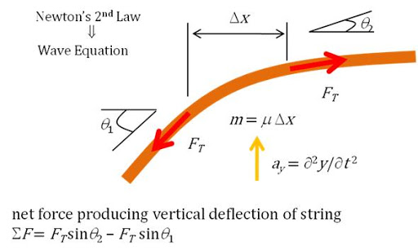
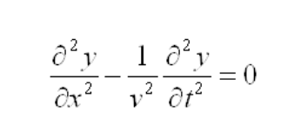
Differential Equations
Tell us about the rate of change of a variable.
Most physical problems can be expressed as DEs
Note on solutions – we also have to specify an initial value (the DE tells us how the variable changes)

Slide 6
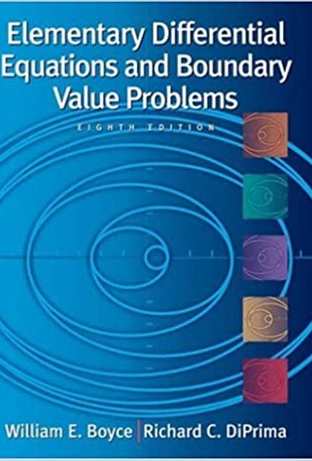
Solving DEs
Big Topic

Slide 7
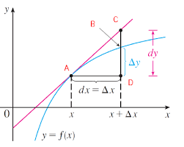
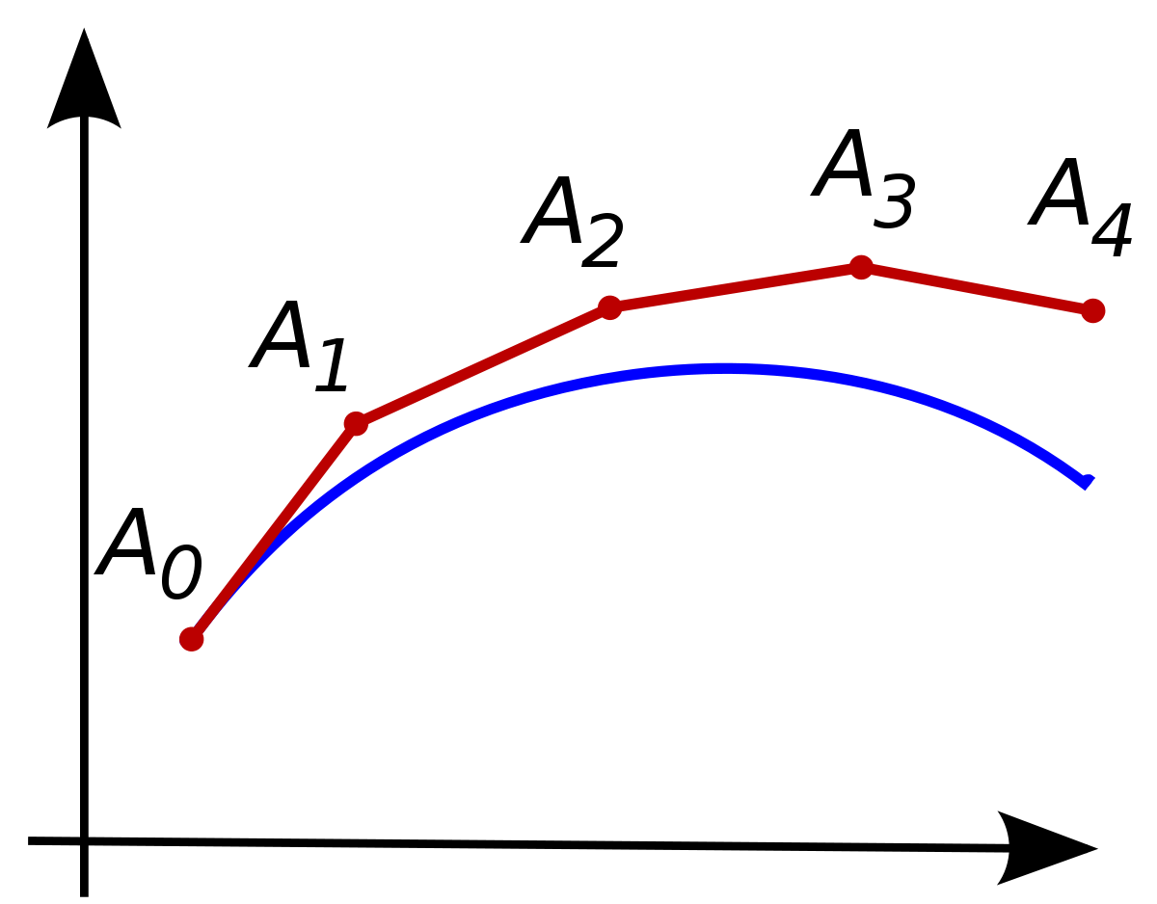

Solving (approximately)DEs using a computer
Idea: $\frac{dy}{dx}=f\left(x\right)$ tells us the rate of change of $y$ for a given value of $x$.
For a small change in $x$, from $x_{0 }$to $x_{0}+Δx$, the change in $y$ is:
$$Δy =\left(rate of change\right)×(change in x)$$
$$=\frac{dy}{dx}×Δx$$
$$=f\left(x_{o}\right)×Δx$$
If you do this trick many times, you can find $y$ for any value of $x$

Slide 8
A worked example

Slide 9

More Detail
The choice of timestep ($Δx$) matters
The way we compute $Δy$ matters.

Slide 10
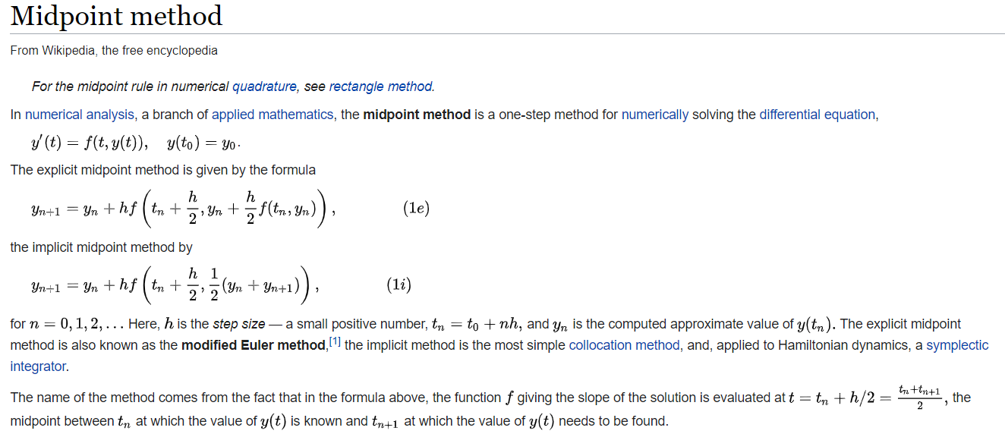
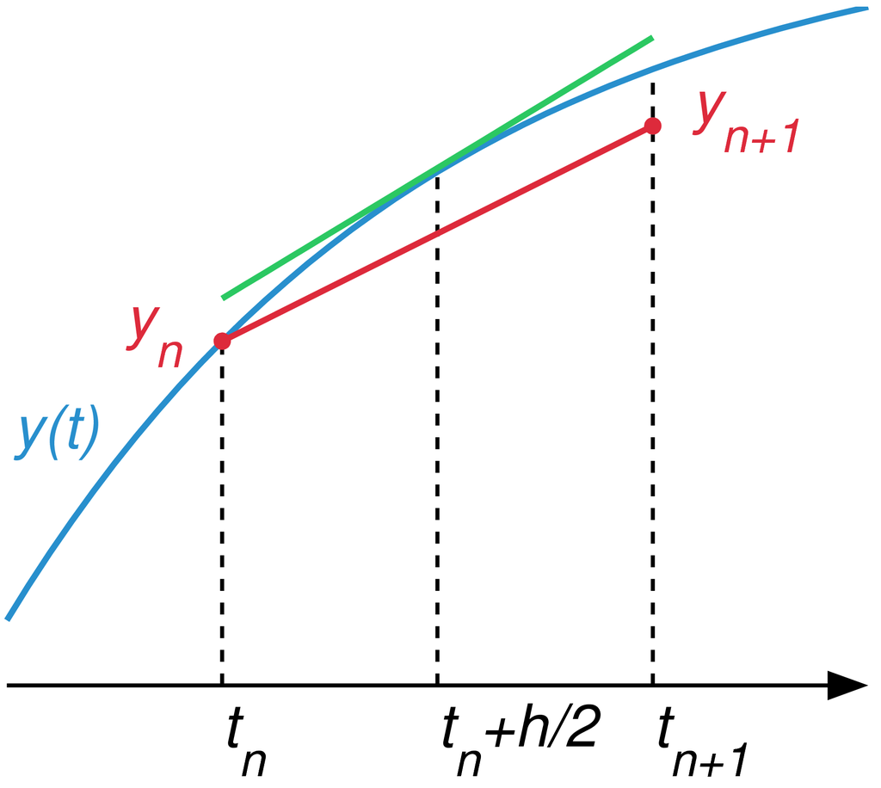
Example – Midpoint Method

Slide 11
